Slide 1
Sample mmm
Mars

Slide 2
Overall results

Slide 3
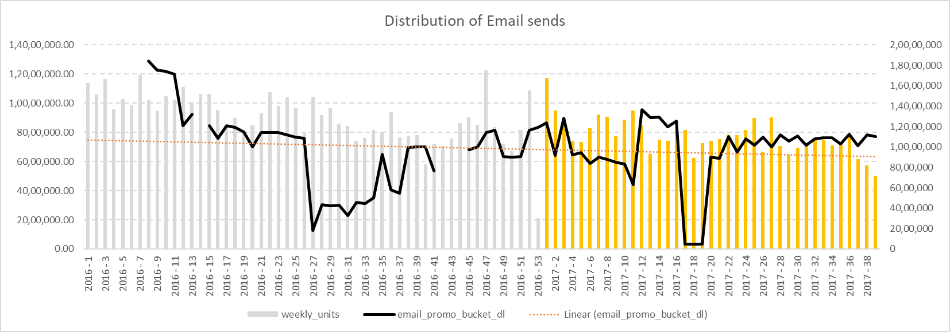
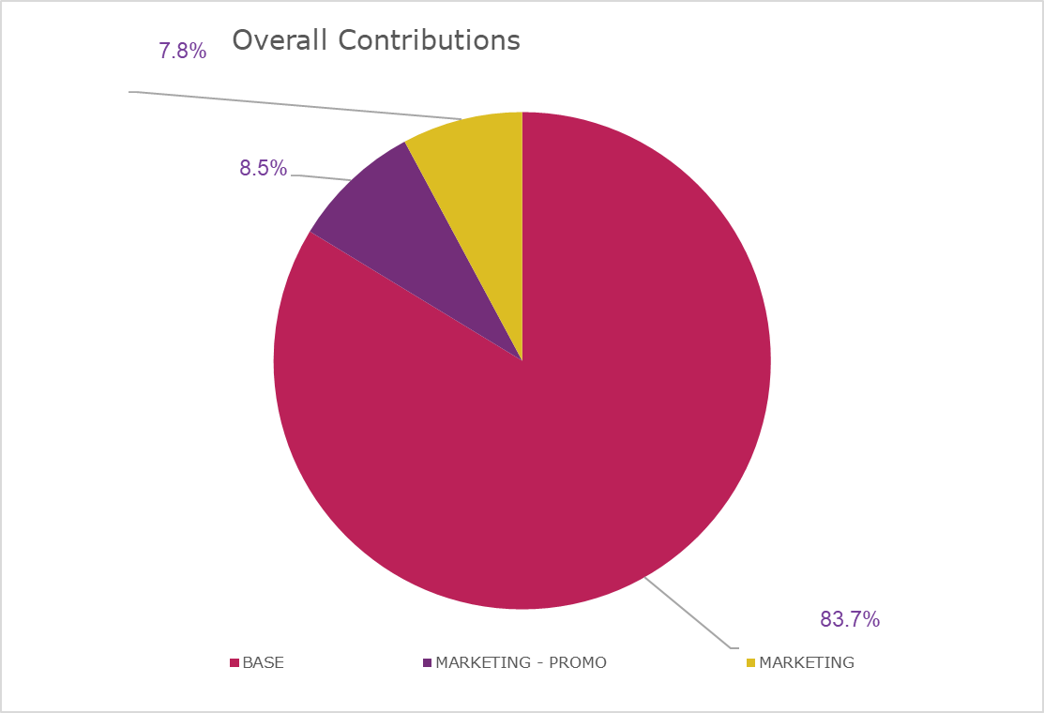
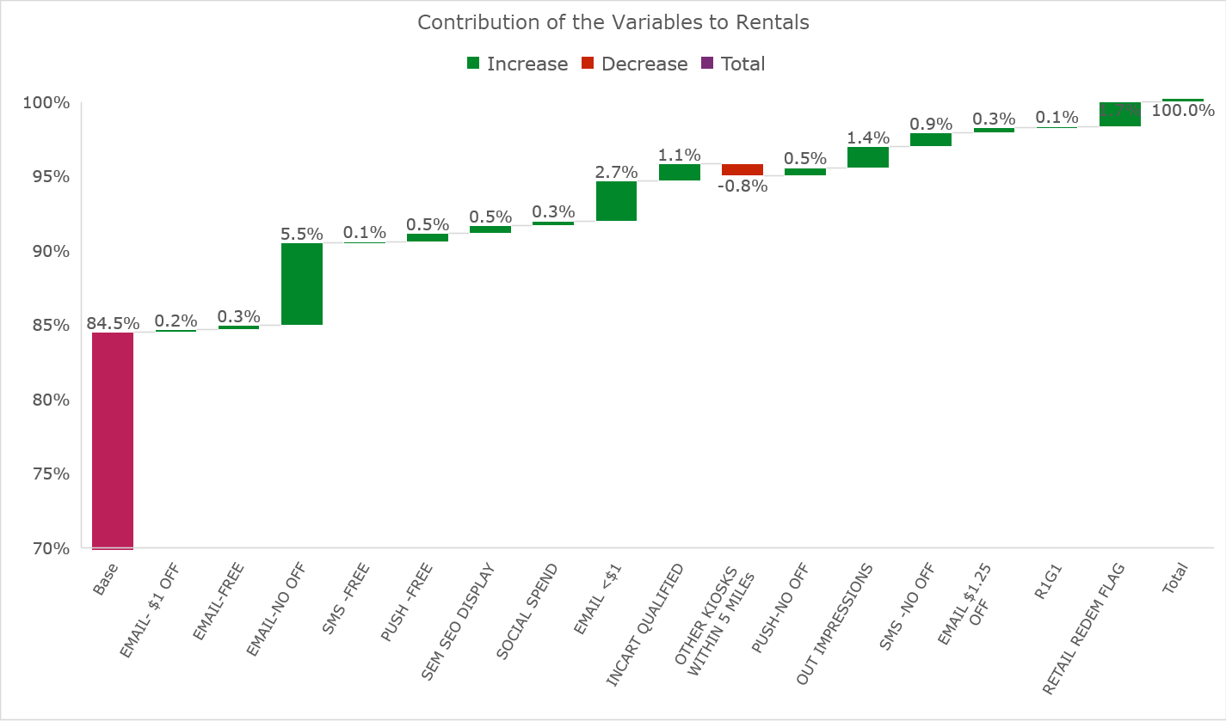

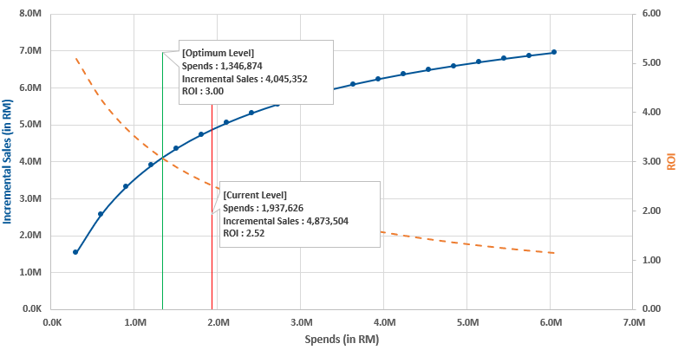
Approach Overview
1
Data
2
Solution
3
Output
Retail (Nielsen)
Data Analysis & Hypothesis Generation
Marketing Effectiveness - Contributions
Sales
Pricing
Brand
TV
Radio
NNP
OOH
Sampling
Roadshow
Activation
Education Marketing
Digital
Facebook
Google SEM
YouTube
Programmatic
Influencers
Category & Channel
Statistical Modelling
Price Support
Product Ambassadors
POSM
Optimal Marketing Mix - ROI Curves
Channel Activities
Premiums
Competitor
2.5 years of data were analysed and ~50 iterations were developed to arrive at the final model
Marketing
Pricing
Macroeconomic
Unemployment

Slide 4
Model Performance Summary
Brand 1 Core
Key Model Stats
Metric | Value
R-squared | 61.4%
Adj. R-squared | 58.6%
MAPE | 6.3%
MAPE – [Mean Absolute Percent Error] is the average percentage difference between predicted & actual weekly sales
Analysis Period : Mar 2017 to Jun 2020 (2017-02-27 to 2020-06-28)

Slide 5
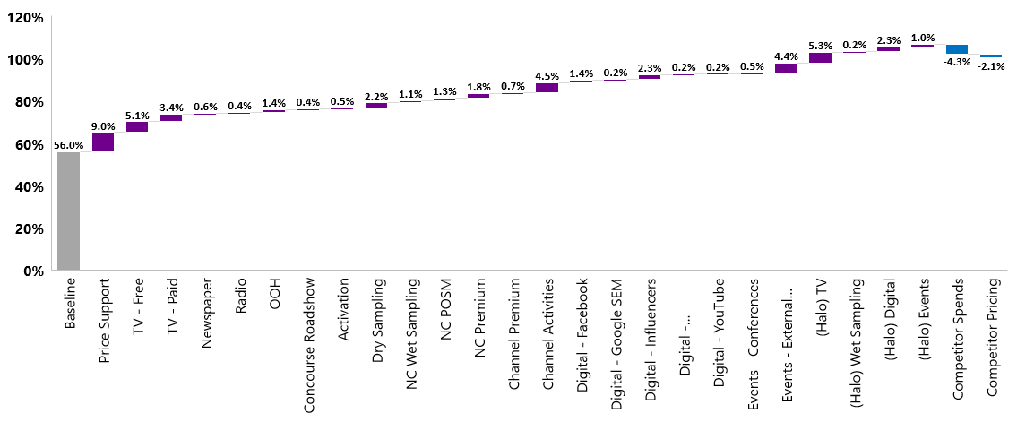
Contributions - Brand 1 Core
Brand 1 Core- ~56% sales are due to baseline momentum
BTL Channels contributes more than ATL for Brand 1 Core
Competitor price and marketing has a negative 6.4% impact whereas Halo impact of spends on other brands contribute 8.9%
HCN
[4.9%]
ATL
[10.9%]
BTL
[12.5%]
Digital
[4.3%]
Halo
[8.9%]
(Online + HCN)
Back to Agenda

Slide 6
ROI - Brand 1 Core
 | Contribution | Spends* (in $) | Incremental Sales* (in $) | ROI
Baseline | 56.0%
Price Support | 9.0% | 4.7M | 6.8M | 1.45
TV - Free | 5.1% | 1.9M | 3.9M | 1.99
TV - Paid | 3.4% | 735.4K | 2.6M | 3.52
Newspaper | 0.6% | 181.6K | 446.6K | 2.46
Radio | 0.4% | 109.3K | 268.9K | 2.46
OOH | 1.4% | 568.0K | 1.1M | 1.86
Concourse Roadshow | 0.4% | 289.5K | 312.3K
Activation | 0.5% | 355.7K | 383.7K
Dry Sampling | 2.2% | 113.7K | 1.7M | 14.85
NC Wet Sampling | 1.1% | 91.9K | 858.1K
NC POSM | 1.3% | 243.1K | 1.0M
NC Premium | 1.8% | 1.0M | 1.4M
Channel Premium | 0.7% | 418.4K | 548.0K | 1.31
Channel Activities | 4.5% | 739K | 3.3M | 4.5
 | Contribution | Spends* (in $) | Incremental Sales* (in $) | ROI
Digital - Facebook | 1.4% | 181.9K | 1.1M | 6.01
Digital - Google SEM | 0.2% | 28.2K | 169.7K | 6.01
Digital - Influencers | 2.3% | 66.7K | 1.7M | 26.21
Digital - Programmatic | 0.2% | 48.4K | 144.6K | 2.99
Digital - YouTube | 0.2% | 41.7K | 124.4K | 2.99
Events - Conferences | 0.5% | 56.1K | 342.5K | 6.10
Events - External CXEs | 4.4% | 295.4K | 3.4M | 11.39
(Halo) TV | 5.3% | 1.6M | 4.1M
(Halo) Wet Sampling | 0.2% | 17.0K | 158.8K
(Halo) Digital | 2.3% | 360.3K | 1.7M
(Halo) Events | 1.0% | 127.6K | 778.9K
Competitor Spends | -4.3%
Competitor Pricing | -2.1%
Digital
ATL
HCN
(Online + HCN)
BTL
Halo
Spends & Incremental Sales are quarterly averages over the analysis period – 2017’Jan – 2019’May
Direct ROI** – Does not include the halo impact on other products

Slide 7
media 1 : insights

Slide 8

Media 1 – OVERALL Performance
Overall Summary - Quarterly
Spends | Incremental Sales | ROI
1.26 M | 5.97 M | 4.74
Spends & Incremental Sales are quarterly averages over the analysis period – 2017’Jan – 2019’May

Slide 9
Media 1 – 2020 Recommendations
Overall Average Spends
2019 Average Spends
Recommended Spends
1.26 M
0.72 M
1.17 M
Recommended increase in quarterly spends by 62%
TV ads for Brand 1 Core Plus have the highest halo effect on Brand 1 Core than other combinations
Spends & Incremental Sales are quarterly averages over the analysis period – 2017’Jan – 2019’May
Back to Agenda

Slide 10
digital vs offline media : Insights

Slide 11
Media | Historical Spending | Digital vs. Offline
Significant shift in focus towards Digital Media over the past few years. Offline Media has taken the maximum hit in budget
Distribution of Spending - Across Years
2020 YTD data available till June 28, 2020

Slide 12
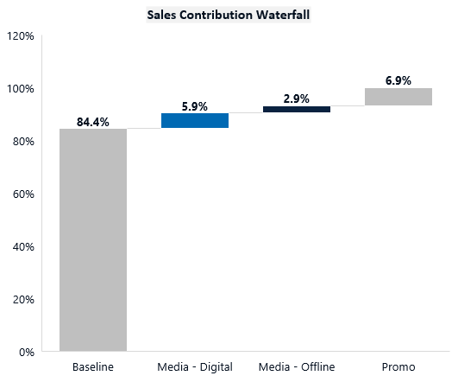
Media | Performance Breakdown | Digital vs. Offline
Digital (5.9%) has ~2x the contribution of Offline (2.9%) in the analysis period
Digital has the higher long-term ROI of 3.3, compared to Offline with long-term ROI of 1.1
Performance Summary
 | Spends | Incremental Sales | Sales Contribution | ROI
Media - Digital | 8.5M | 54.0M | 5.9% | 3.0
Media - Offline | 5.9M | 26.5M | 2.9% | 3.4
Total | 14.4M | 80.5M | 8.7% | 3.1
Media
Promo
~8.7% Overall Sales Contribution
Analysis Period : Mar 2017 to Jun 2020 (2017-02-27 to 2020-06-28) | For Les Recoltes Bio : Apr 2018 to Jun 2020 (2018-04-02 to 2020-06-28)

Slide 13
Media | Recommended Mix for 2021 | Digital vs. Offline
Though Digital has been performing better than Offline, a 70/30 mix between Digital and Offline is ideal for maximizing the ROI
Recommended Mix
Optimization Summary (Forecast for 2021)
Spends |  |  | Incremental Sales |  |  | ROI
Current | Optimized | % Change | Current | Optimized | % Change | Current | Optimized | % Change
3.0M | 3.8M | 27% | 32.0M | 35.1M | 10% | 10.7 | 9.2 | -13%
Recommended Spends for 2021
 | Current Spends | Recommended Spends | Spends % Change
Media - Digital | 2.5M | 2.6M | 7%
Media - Offline | 523.8K | 1.2M | 120%
Analysis Period : Mar 2017 to Jun 2020 (2017-02-27 to 2020-06-28) | For Les Recoltes Bio : Apr 2018 to Jun 2020 (2018-04-02 to 2020-06-28)
Forecast & Recommendation for 2021 : Non-Spends variables (trend, pricing, distribution etc.) extrapolated for 2021 based on 2019 + 2020 YTD data
Budget constraints considered for 2021 Optimization : Budget & Optimization Constraints

Slide 14
appendix

Slide 15
Modelling Approach (1/5)
1
Data Preparation
1.1 | Raw Data Collation | Collecting all the required data
1.2 | Data Pre-Processing | Manual processing of the received data (if needed) to a python readable format
1.3 | Data Processing | Script to collate raw/pre-processed flat files to a single cleaned file for every data source
1.4 | Data Filtering and Aggregation | Filtering the relevant data and aggregating to the required level
1.5 | Data Apportioning | Apportioning/distributing non-granular data. Example: monthly to weekly
1.6 | Missing Value Treatment | Data imputation or missing value removal
1.7 | Outlier Treatment | Data imputation for outlier removal
1.8 | ADS Creation | Merging all the required data sources to create ADS
1.9 | Business Validation | Validation of the Topline numbers with the business

Slide 16
Modelling Approach (2/5)
2
Exploratory Data Analysis
2.1 | Univariate Analysis | Univariate analysis is primarily used to describe the data gained from marketing mix elements and find patterns that exist within them
2.2 | Trend Analysis | Trend of every marketing channel is studied to understand the spend pattern over the years
2.3 | Bivariate Analysis | Bivariate analysis is done to understand the relationship between two different variables among marketing mix elements. In MMM, Bivariate analysis helps us to Identify the key variables that exhibit a good relationship with the dependent variable Identify the type of relationship that the variable exhibits with the dependent variable, to help with variable transformations Relationship between two numerical variables are visualized using scatter plots and line charts

Slide 17
Modelling Approach (3/5)
3
Feature Engineering & Variable Transformations
3.1 | Lag | Marketing spends are lagged to capture the lagged effect of marketing on sales
3.2 | Adstock | Advertising adstock is the prolonged or carry-over effect of advertising on consumer purchase behaviour
3.3 | Aggregation of Variables | Similar marketing touchpoints which have similar response on sales are aggreated and modelled together
3.4 | Log Transformation | Advertising activities will have non-linear impact on the KPI’s and they exhibit a pattern of diminishing returns. This relationship can be captured in form of log transformations. Independent variables are log transformed in addition to the target variable

Slide 18
Modelling Approach (4/5)
4
Modelling
4.1 | Model Equation | To overcome the limitations inherent in linear models, multiplicative models are used, which offer a more realistic representation of the market response than additive linear models do. In this model, independent variables are multiplied together instead of added. Sales = exp(Intercept) * exp(β1*(adstocked(lagged(Marketing Spends 1))) * exp(β2*adstocked(lagged(Marketing Spends 2))) * exp(β3*adstocked(lagged(Marketing Spends 3))) *…
4.2 | Model & Variable Selection | Statistical Significance : Statistically significance of variables - p values for each variable < 0.05 (or) 0.1 to reject the null hypothesis (the predictor are not associated with changes in the response) Business Logic : Correct sign/direction for the coefficients based on actual market scenario and business input. The sign of each coefficient indicates the direction of the relationship between a predictor variable and the response variable. Example: Marketing activities should have positive impact on sales. Solo breastfeeding rate should have a negative impact on Infant Nutrition Sales

Slide 19
Modelling Approach (5/5)
4
Modelling
4.3 | Model Diagnostics | Adjusted R Squared : The proportion of the variance for a dependent variable that's explained independent variables. Adjusted R-squared compensates for the addition of variables Variable Inflation Factor : A variance inflation factor (VIF) detects multicollinearity in regression analysis. Max threshold of 5 is considered MAPE : Average absolute percent error for each observation or predicted values minus actuals divided by actuals
4.4 | Contribution Calculation | Since the sales is construed as the result of the multiplication of various factors, it is not possible to distinguish the resulting sales into the separate non-overlapping effect of the different factors. Hence, contribution is be defined as the difference in total sales and the sales upon removal of the effect of that regressor. This gives us an idea about the degree of influence each regressor has on the actual sales across the time period

Slide 20
Thank you !

